Slide 1
Rubric Innovation in Canvas: Enhanced Tools and AI-Powered Features Training
Tanem Coskun, M.Ed., MS.

Slide 2
Objectives
Understand the Purpose and Value of Enhanced Rubrics
Navigate and Activate the Enhanced Rubrics Feature
Recognize the Enhanced Rubrics AI Feature
Connect Learning Outcomes to Rubric Criteria
Apply Enhanced Rubrics Through Modeling and Practice

Slide 3
Old Rubrics vs Enhanced Rubrics
Old Rubrics:
Limited editing
Fixed workflows
Basic use
Reuse is less flexible
Enhanced Rubrics:
Centralized rubric manager: search, sort, view usage locations, duplicate, and archive
Change in aesthetics for better usability

Slide 4
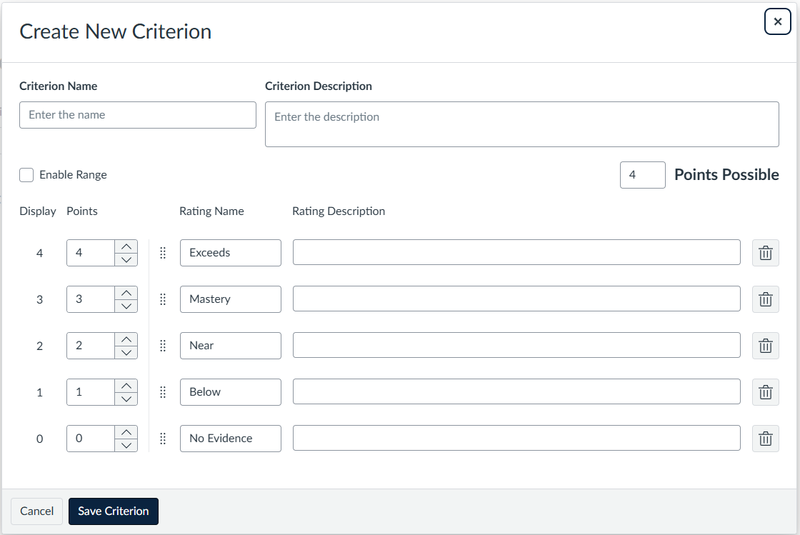
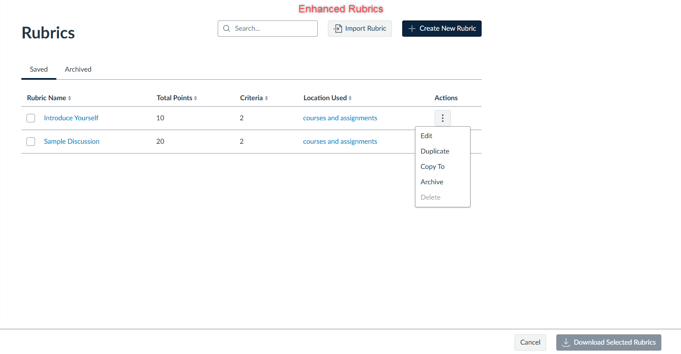
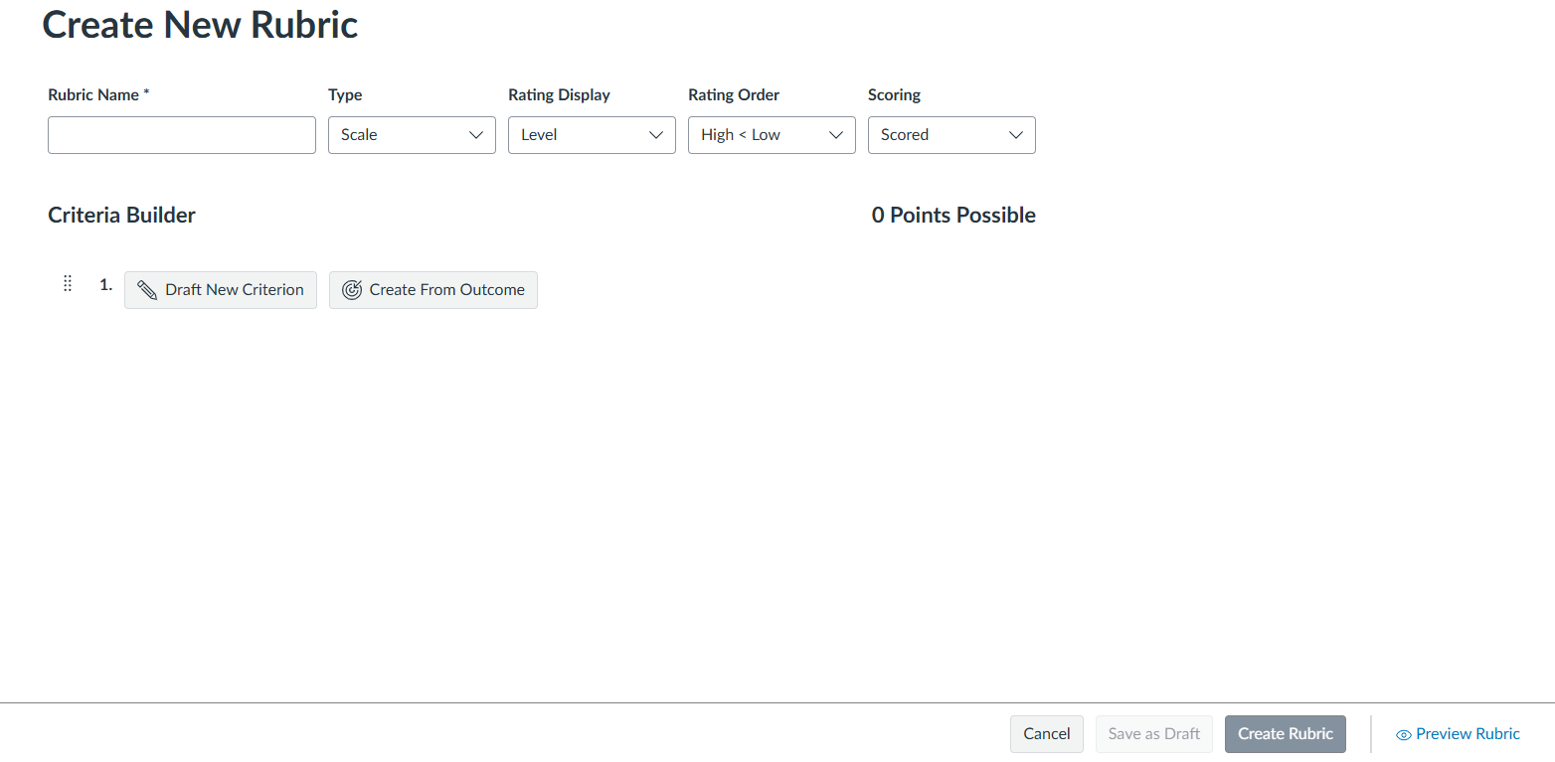
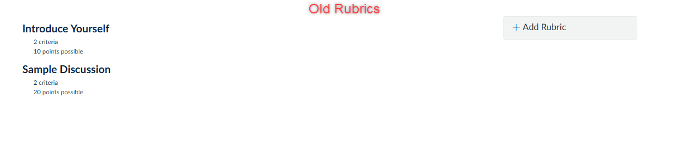
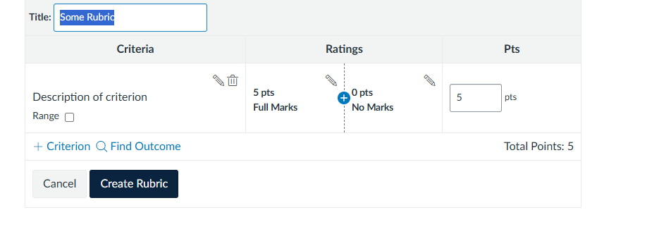
Old Rubrics vs Enhanced Rubrics

Slide 5
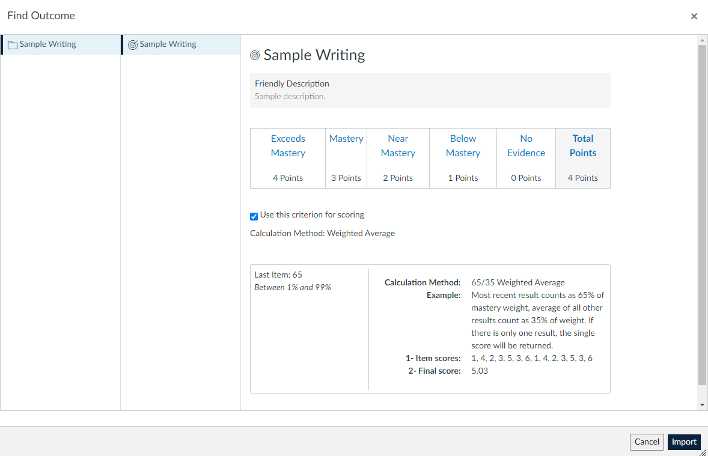
Importing Outcomes with Enhanced Rubrics
Choose the outcome that best matches your assessment goal.
Review the levels and points that will be imported.
Click Import to add the outcome as a criterion.
Select an outcome on the left, then import it into the rubric.

Slide 6
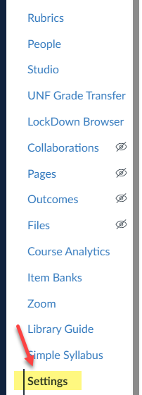

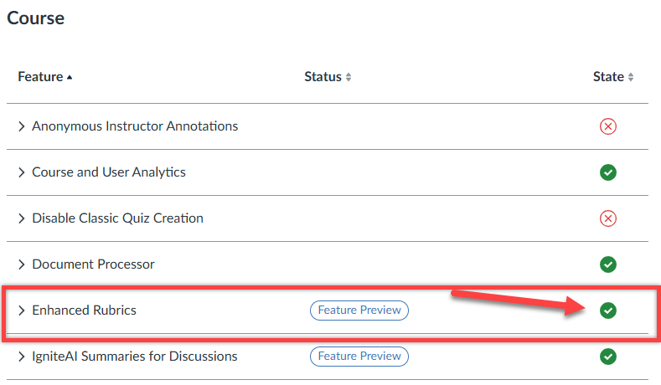

Turning on Enhance Rubric
Course Settings > Feature Options > Enhanced Rubrics

Slide 7
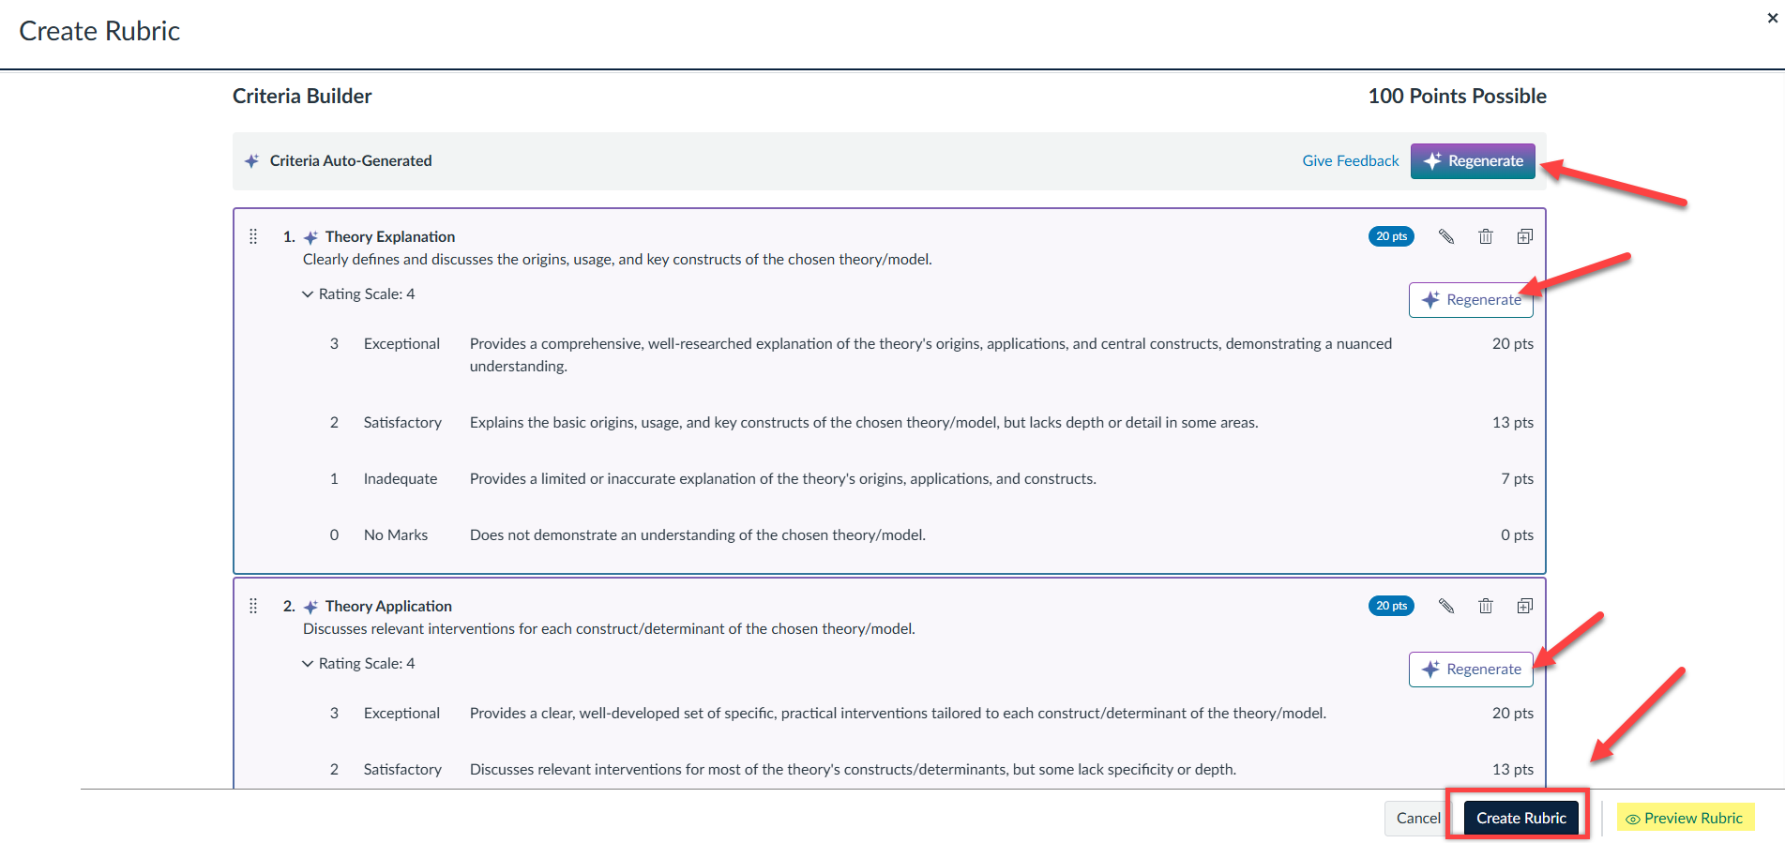
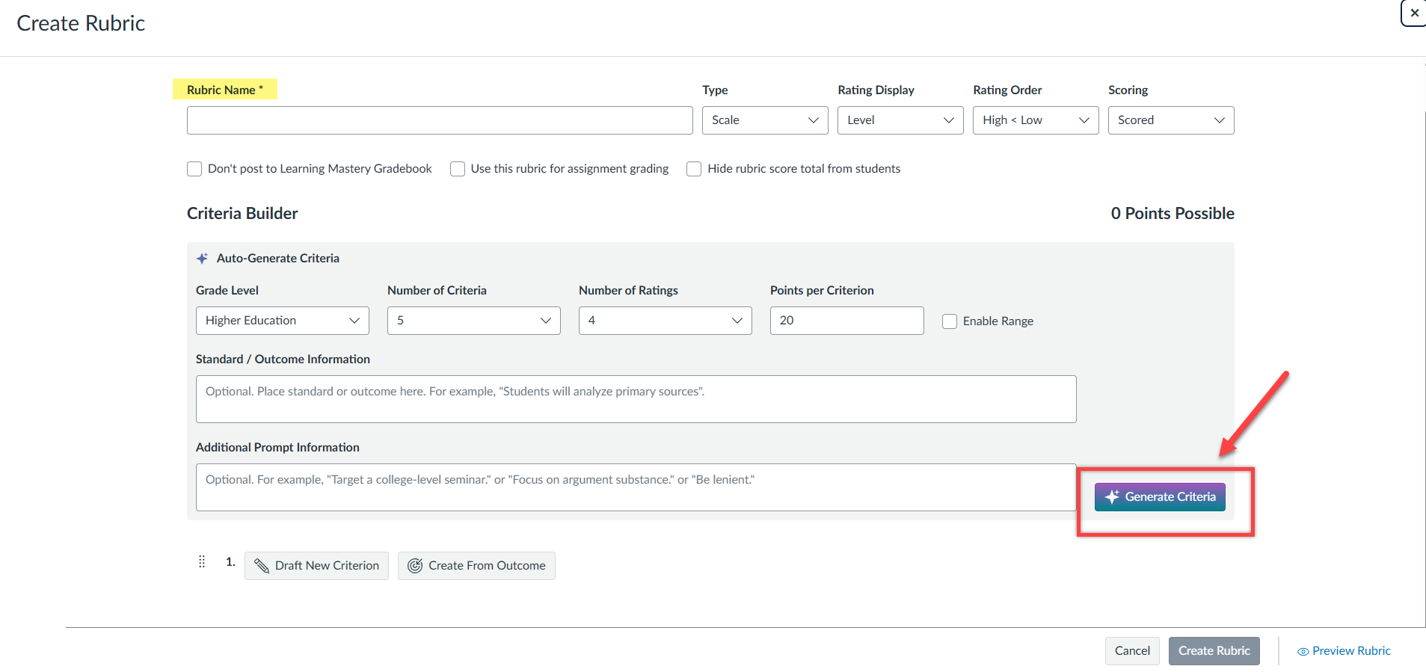
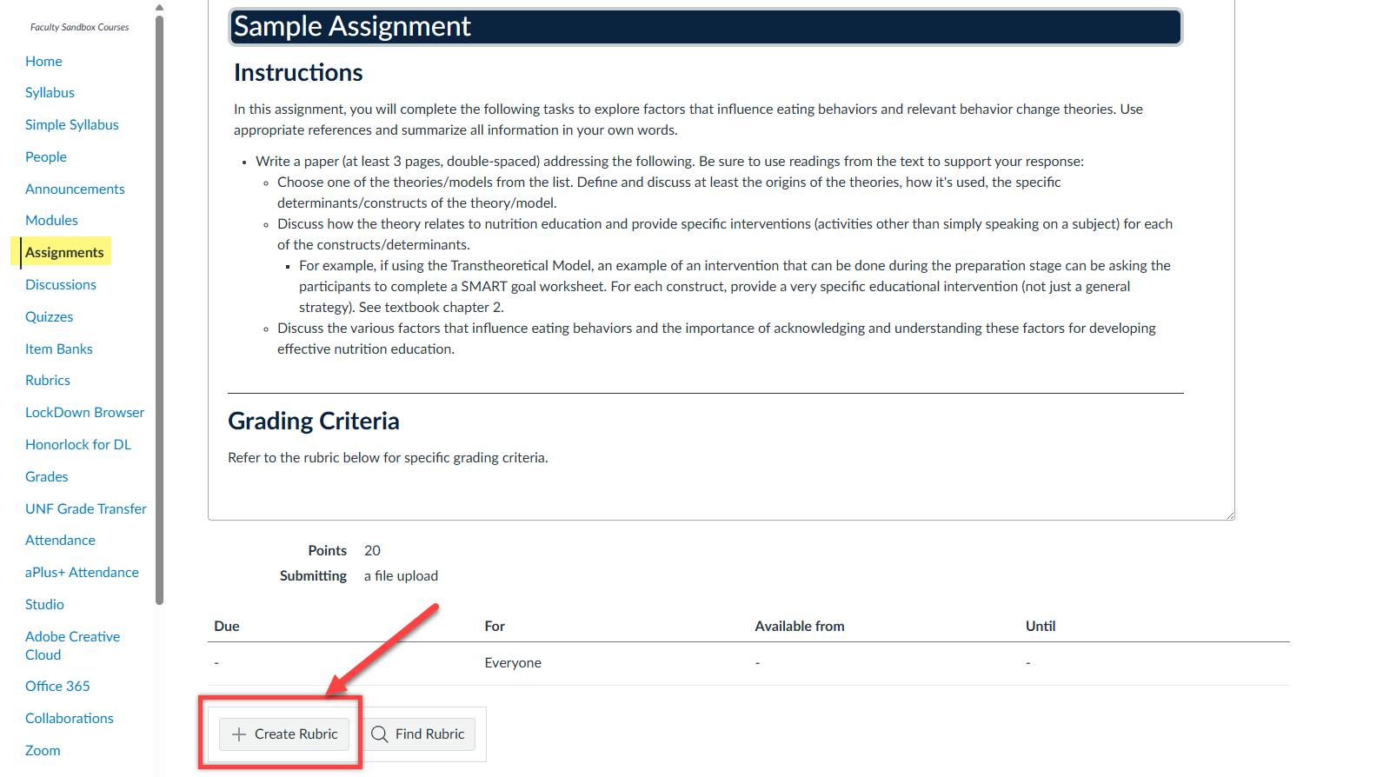
Enhanced Rubrics AI Feature

Slide 8
Enhanced Rubric Demo
I Do:
  Inserting outcomes to rubrics
  Add rubrics to multiple assignments
  Walkthrough of the AI Feature
  Rubrics in SpeedGrader
We Do:
  Creating Rubrics together
You Do:
  Creating a basic rubric by using Enhanced Rubrics

Slide 9
Exit Slip: 3, 2, 1
3 things you learned or hesitant about the AI feature
2 instances that you plan to use the AI feature for rubrics
1 question you still have

Slide 10
Thank you for joining me today!

