Slide 1



Features, Designs, and Principles:
Computer Simulations and Virtual Laboratories
EDF 7215: Learning and Instruction throughout the Lifespan
TANEM COSKUN, VANESSA B. CRUZ, SHERYL PATTERSON-COULIBALY

Slide 2

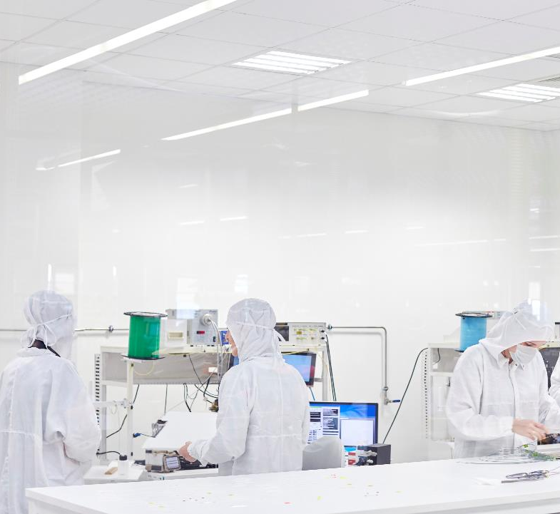




Learning Objectives
You will be able to…
Describe the role of computer simulations and virtual labs (CS/VLs) in supporting the learning of science
Identify the instructional design features that make CS/VLs effective
Analyze the advantages and disadvantages of simulation-based instruction
Connect principles of simulation design to classroom application via a guided chemistry activity

Slide 3


Chapter Introduction
Investigates whether guided simulations lead to better learning than pure discovery
Examines if simulations are better than traditional real labs
Finds that effective learning requires balancing freedom and structure in technology-enhanced learning
Simulations support hypotheses testing, variable manipulation, and the dynamic showing of results
This will help students engage with complex scientific systems and create deep conceptual understanding and transfer

Slide 4
Historical Overview
Early simulation use in aviation, military, and medicine for skill training
Computer-based simulation grew rapidly in educational since the 1980s
Major shift came with intelligent tutoring systems enabling conceptual learning and guidance
Smithtown was one of the first to support conceptual learning with embedded scaffolding

Slide 5
Theoretical Framework
Simulations promote learning through questioning and re-organizing knowledge
Based on inquiry cycles: orientation, hypotheses generation, experimentation, and reflection
Present information at different levels (graphs, tables, animation) to deepen understanding
Learning control is transferred to students which improves engagement and motivation

Slide 6
Theoretical Framework (Cont.)
Simulations can improve reality: eliminate measurement error, allow fast repetition.
Support hypothesis testing, variable manipulation and outcome visualization.
Help students engage with complex scientific systems to build deep understanding.

Slide 7
Current Trends
Research shows simulations with instructional guidance are most effective
Learning in unguided discovery is very weak
Guided simulations produce better results for STEM subjects and conceptual learning
Key design factors:
Learner control over inputs.
An authentic and meaningful task.
Immediate feedback on performance.
Trial and error or experimentation opportunities.

Slide 8
Current Issues
Too much open exploration without support can overwhelm students
To make simulations effective, they need to fit into a larger teaching plan
Students with higher prior knowledge can benefit more from open-ended simulations

Slide 9
Practical Implications
Simulations outperform traditional instruction through guidance
PhET, ChemCollective, and Go-Lab offer tested, usable simulations
Successful use needs both technical and pedagogical teacher training
Teachers play a key role in integrating simulations into instruction
Teachers should give explicit learning goals and reflection prompts to deepen student understanding

Slide 10

Activity: Exploring Hess’s Law
You will work on one of the three reactions in a virtual calorimeter in a breakout room. In the case you will be working on, you will measure the temperature change with your group. The we will compare the results on each case when we all come together. The goal is to see if the heat evolved is consistent, supporting Hess’s Law.
Objective:
To explore whether taking different "paths" in a chemical reaction releases the same amount of heat, a concept behind Hess’s Law.
Instructions:
Use ChemCollective Virtual Lab to complete a virtual calorimetry experiment
Perform three variations of reactions involving NaOH and HCl
Measure and compare temperature changes in each scenario
Reinforces: simulation-based inquiry, guided learning, multiple representations, safety, and motivation
Use this ChemCollective Virtual Lab Handout to document your findings:
  Group 1
  Group 2
  Group 3
Breakout Room Groups:
Group 1 - Part A: NaOH + Water
Group 2 - Part B: NaOH solution + HCl
Group 3 - Part C: Solid NaOH + HCl

Slide 11
Learning Objectives
Small Group Roles:
  Timekeeper: Ensures discussion remains within the eight-minute timeframe.
  Reporter: Presents a concise, 30-second summary of the group’s discussion upon returning to the main room.
  Collaborator: to ensure all voices are valued, everyone is asked to participate and engage with this activity.
You will be able to…
Describe the role of computer simulations and virtual labs (CS/VLs) in supporting the learning of science
Identify the instructional design features that make CS/VLs effective
Analyze the advantages and disadvantages of simulation-based instruction
Connect principles of simulation design to classroom application via a guided chemistry activity

Slide 12
Debrief: Small Group Conversation
Choose four to discuss
Where in your curriculum could this virtual-lab approach replace or enhance a traditional hands-on lab, and what scaffolds would you layer in to keep learning on track?
How could CS/VLs boost inquiry and motivation for students who may lack prior lab access or need alternative pathways? What metrics would show success?
Imagine students mastering Hess’s Law in this space. How does that knowledge show up in everyday problem-solving or STEM careers?
What technical, pedagogical, or equity-related challenges might you face implementing CS/VLs, and what strategies could counter them?

Slide 13
Debrief: Small Group Conversation (Cont.)
Choose four to discuss
How might CS/VLs be used in subjects like history or civics to simulate complex systems, decision-making processes, or historical events? What benefits would this bring to student engagement and understanding?
In subjects like ELA or foreign language, how could immersive simulations or virtual environments support storytelling, language acquisition, or cultural exploration?
How might the use of computer simulations and virtual environments enhance learning, training, or decision-making in your professional field, whether in business, healthcare, nonprofit leadership, or another sector? What considerations would you need to make for your specific audience?

Slide 14

Debrief: Main Room Share Out
Welcome Back!
Let’s hear from each of our group’s reporters!
Final Thoughts:
What is one instructional adjustment or idea you are considering as a result of today’s facilitation?

Slide 15
Debrief: Future Directions
No single teaching approach suits all students or subject matters
Results of inquiry-based learning get stronger over time with more exposure
Promising areas:
  Cooperative modeling with common workspace and shared diagrams
  Gamification for engagement and motivation (scores, narratives, awards)
  Personalized scaffolding and combination of real and virtual labs
Simulation technology is prepared for broad adoption with right mentoring and backing
Personalized simulation based on student traits (like prior understanding, learning goals)
Combining virtual labs with real or remote lab experiences can extend learning
More research is needed on long-term impacts on achievement and transfer of knowledge

Slide 16


Thank You!
Any questions?

